Slide 1
New Org: What’s important week of May 18
Notes:
New Org Section: For SPs and Partners presenting to New Org agents. These slides are visible to EPs and MPs.

Slide 2
Top Performers
Week of May 18, 2026 — Recognizing This Week’s Honorees
[Agent Name] — [Achievement / Recognition]
[Agent Name] — [Achievement / Recognition]
[Agent Name] — [Achievement / Recognition]
Presenter: Duplicate this slide as needed and fill in honoree names and achievements before the meeting.
Notes:
TOP PERFORMERS — PRESENTER ACTION REQUIRED: Before this meeting, duplicate this slide as needed and fill in each agent's name and their achievement for the week. Remove this placeholder row when finished. Recognize each honoree individually by name and call out their specific accomplishment.

Slide 3
Market Week Overview
Week Ending May 16, 2026
Week Ahead: May 18-22, 2026
Notes:
Market Week Overview — This section covers the market activity for the week ending May 16, 2026, and what to watch in the week ahead (May 18-22). Use this slide as a brief transition into the market update. Remind your team that markets ended the week with a modest gain, extending the S&P 500 win streak, but Friday saw selling pressure driven by the ongoing Iran conflict and an anticlimactic Trump-Xi summit outcome.

Slide 4
Week in Review: U.S. Markets Overview
Market Performance (May 12-16, 2026)
S&P 500: Extended its weekly winning streak to close at approximately 7,408 — up modestly for the week, though Friday saw a sharp -1.24% selloff on Iran/energy concerns and Trump-Xi summit disappointment.
Nasdaq Composite: Pulled back -1.5% on Friday as investors rotated out of tech and took profits following Cisco's mid-week blowout. Weekly performance was mixed overall.
Dow Jones: Down approximately -1.1% on Friday; the week overall was flat to slightly positive.
Key Mid-Week Catalyst: Cisco Systems (CSCO) reported blowout Q3 earnings — AI infrastructure orders raised to $9 billion from a prior $5 billion forecast, a 80% increase. Shares surged.
Tech Profit-Taking: Nvidia (-4.4%), Intel (-5%), AMD (-3%), Micron (-4%) all saw Friday declines. Investors reduced concentrated tech positions heading into next week's Nvidia earnings.
NYLIM View: Per their latest “Pricing Past the Blockade” update, markets are increasingly looking through the Iran conflict — dispersion across regions, sectors, and asset classes is becoming the defining feature of midyear 2026.
Notes:
Week in Review: U.S. Markets Overview The S&P 500 extended its weekly winning streak for the week ending May 16, 2026, though the market gave back significant ground on Friday. The index settled around 7,408, with Friday alone down 1.24%. The Nasdaq fell 1.5% on Friday, and the Dow dropped 1.1% — all tied to renewed energy price concerns from the ongoing U.S.-Iran conflict and investor disappointment with what many called an anticlimactic Trump-Xi summit. The highlight of the week was Cisco's blowout earnings report, which sent the networking giant surging after management raised its AI infrastructure and hyperscaler revenue forecast to $9 billion — up from $5 billion. That is an 80% increase in one quarter. This confirmed that enterprise AI spending is accelerating rapidly. On the flip side, large-cap tech saw profit-taking heading into the pivotal Nvidia earnings next week. Nvidia fell 4.4%, Intel 5%, AMD 3%, and Micron 4%. Investors are positioning carefully ahead of what will be one of the most closely watched earnings calls of the year. NYLIM's latest macro pulse commentary — titled 'Pricing Past the Blockade' — notes that equity markets are holding near highs even as geopolitical risk remains elevated. Their key message: the dispersion in outcomes across regions, sectors, and asset classes is becoming the defining feature of the midyear global environment. This is their framework: not a directional call, but a call for selective, active positioning.

Slide 5
Key Market Drivers Last Week
Three Themes Defined the Week
Iran Conflict & Energy Prices: The ongoing U.S.-Iran conflict continued to pressure energy markets. Oil prices remained elevated near $109/barrel (WTI), keeping inflation concerns alive and limiting the Fed’s flexibility. Markets partially priced in the risk, though concern resurged Friday.
Trump-Xi Summit (Anticlimactic): Investors had hoped for a meaningful U.S.-China trade or diplomatic breakthrough from this week’s Trump-Xi meeting. The summit produced no major announcements, disappointing markets and contributing to Friday’s sell-off.
Cisco AI Orders Signal Acceleration: Cisco raised its AI infrastructure order forecast to $9B (from $5B), confirming hyperscaler and enterprise AI investment is accelerating — a positive signal for the technology sector despite short-term profit-taking.
Fed: Rates Steady, New Chair Era Begins: The Fed held rates at 3.50%-3.75% at its April 29 meeting. The April FOMC minutes will be released Wednesday, May 20 — the first major policy document under new Chair Kevin Warsh. One dissenter (Miran) wanted to cut; three others resisted an easing bias.
Sector Rotation: Defensive names and energy outperformed on Iran risk. Technology underperformed as investors reduced exposure ahead of Nvidia’s pivotal earnings Wednesday.
Notes:
Key Market Drivers Last Week Three themes defined the week ending May 16: 1. IRAN CONFLICT & ENERGY: The ongoing U.S.-Iran conflict remains a significant market overhang. Oil at ~$109/barrel keeps CPI pressured and limits the Fed's ability to cut rates aggressively. Markets have partially priced this in — NYLIM calls it 'pricing past the blockade' — but the risk resurged on Friday. 2. TRUMP-XI SUMMIT: Investors positioned for a potential breakthrough in U.S.-China relations from the Trump-Xi meeting. The summit was largely anticlimactic — no major trade or policy concessions — and this disappointment was cited as a key driver of Friday's sell-off. 3. CISCO AI CONFIRMATION: Cisco's 80% increase in AI order guidance ($5B to $9B) is a significant data point. Enterprise AI spending is accelerating, not decelerating. This has direct positive implications for companies in the AI infrastructure supply chain, particularly Nvidia heading into earnings next week. 4. FED TRANSITION: April 29 FOMC held rates steady at 3.50%-3.75%. New Chair Kevin Warsh now leads the Fed. The April meeting minutes release on Wednesday, May 20 will be the first Powell-era minutes under Warsh's leadership. Markets will scrutinize them for tone shifts and any signal on the pace of potential rate cuts — currently the market expects one cut in 2026.

Slide 6
Economic Reports Calendar: Week Ahead
Key Data Releases to Watch (May 18-22, 2026)
Tuesday 5/19 — Housing Starts (April): New Residential Construction data at 8:30 AM ET. High interest rates at 3.50-3.75% have continued to weigh on housing activity — this print will reveal whether spring demand is recovering. Also: NAR Pending Home Sales Index at 10:00 AM.
Wednesday 5/20 — April FOMC Meeting Minutes: The Fed releases the minutes from its April 29 meeting — the final policy act of the Powell era, and the first major document under new Chair Kevin Warsh’s oversight. Watch for language around rate cuts, inflation tolerance, and any hints on the June meeting outlook.
Thursday 5/21 — Initial Jobless Claims + Philly Fed: Weekly jobless claims (8:30 AM) provide a real-time read on labor market health. Philadelphia Fed Manufacturing Survey (8:30 AM) will gauge regional industrial conditions. Both indicators are closely watched given current stagflation concerns.
Friday 5/22 — Michigan Consumer Sentiment (Final): The final May reading of consumer confidence (10:00 AM). With energy prices elevated and geopolitical uncertainty high, expect this to be closely scrutinized for any deterioration in consumer outlook or inflation expectations.
Also This Week: Durable Goods Orders (April preliminary) — measures new orders for manufactured goods and is a leading indicator of business investment. A strong reading would support economic resilience narratives.
Notes:
Economic Reports Calendar: Week Ahead (May 18-22, 2026) This is a moderate data week with several important releases: TUESDAY 5/19 — HOUSING STARTS (April): The housing market has been in a tug-of-war between high interest rates (suppressing affordability) and tight supply (supporting prices). This report will tell us if spring activity is picking up. Watch both starts AND permits as a forward indicator. Pending Home Sales will add color on near-term contract activity. WEDNESDAY 5/20 — FOMC MINUTES: This is the most market-moving event of the week. The April 29 FOMC minutes mark the transition from Jerome Powell's final act to Kevin Warsh's new era. Investors will parse every word for: (a) tolerance for inflation at current levels, (b) conditions needed to cut rates, and (c) any dissension around the current 'one cut in 2026' baseline. The yield curve will react to this release. THURSDAY 5/21 — CLAIMS + PHILLY FED: Weekly claims under 220,000 = healthy. A surprise spike would signal labor market softening. The Philly Fed index has been volatile; a reading above zero indicates expansion in the Mid-Atlantic manufacturing region. FRIDAY 5/22 — MICHIGAN SENTIMENT: This is the number clients will feel personally. Elevated gas prices from the Iran conflict are already affecting consumer mood. Watch the 5-10 year inflation expectations component — if it rises, it complicates the Fed's path significantly. For talking points with clients: This week's data will help clarify whether the U.S. economy is softening or just digesting geopolitical headwinds. Either way, the Fed is unlikely to move before June.

Slide 7
Earnings Calendar: Week Ahead
Key S&P 500 Companies Reporting (May 19-22, 2026)
Nvidia (NVDA) — Wednesday 5/21: The most closely watched earnings call of the quarter. Wall Street wants to see: data center revenue growth, gross margin direction, China demand, and Q2/full-year guidance. Cisco’s $9B AI order upgrade last week raises the bar. Result could set tone for the entire tech sector.
Walmart (WMT) — Thursday 5/22: World’s largest retailer reports Q1 FY27. Analysts expect EPS ~$0.65 on revenue of ~$173B. Walmart is up ~15% YTD and near all-time highs. Watch commentary on consumer spending health, private label trends, and tariff/energy cost pass-through.
Home Depot (HD) — Tuesday 5/20: HD’s result will indicate whether high interest rates are still dampening home improvement spending. With housing turnover low, DIY and pro contractor demand are key metrics to watch.
Target (TGT) — Wednesday 5/21: Q1 FY27 results before market open. Wall Street expects EPS ~$1.34-1.35 on revenue of ~$24.3-24.6B. Target has faced margin pressure — watch for any improvement in discretionary categories.
Lowe’s (LOW) — Wednesday 5/21 | Palo Alto Networks (PANW) — Thursday: Lowe’s pairs with Home Depot for a complete picture of housing-adjacent spending. Palo Alto reports Thursday — a bellwether for enterprise cybersecurity budgets amid heightened geopolitical tensions.
Notes:
Earnings Calendar: Week Ahead (May 19-22, 2026) This is arguably the most important earnings week remaining in the Q1 reporting season. Here is your roadmap: NVIDIA (NVDA) — Wednesday 5/21: This is THE earnings event of the week. Nvidia has been the central engine of the AI trade. After Cisco's massive $9B AI order guidance raise, expectations are very high. Key items to watch: (1) Data center revenue — consensus expects continued explosive growth; (2) Gross margins — any compression would be a negative signal; (3) China demand — export restrictions have limited sales to China, any update here is critical; (4) Forward guidance — the market is pricing perfection, so guidance tone matters enormously. A beat-and-raise will likely send tech broadly higher. A miss or cautious guidance could trigger a significant pullback. WALMART (WMT) — Thursday 5/22: Walmart is the best barometer of the American consumer. With oil-driven inflation pressuring household budgets, Walmart's commentary on consumer behavior will be closely watched. Up 15% YTD, it is priced for excellence. Watch for: (1) Comp store sales; (2) E-commerce growth; (3) Any tariff or supply chain commentary; (4) Private label adoption (trade-down indicator). HOME DEPOT (HD) + LOWE'S (LOW): Together these give a complete picture of housing-adjacent consumer spending. With mortgage rates still elevated, housing turnover is low — meaning fewer people are buying homes and therefore doing less renovation. Both companies have been managing through this environment. Watch for any signal that rate cuts or spring demand are helping. TARGET (TGT): Target has been navigating margin pressures in discretionary categories. Any improvement in apparel or home goods would be a positive signal for broader consumer health. PALO ALTO NETWORKS (PANW): Geopolitical tensions have driven enterprise cybersecurity spending. Watch for platform consolidation commentary and ARR growth.

Slide 8
Client Talking Points: What This Means for You
Plain-English Summary for Client Conversations
Markets Had a Good Week — With a Bumpy Finish: Stocks generally rose this past week, with the S&P 500 extending its winning streak. However, Friday saw a pullback tied to ongoing tensions in the Middle East and a disappointing U.S.-China summit. Short-term volatility is normal, especially when geopolitical headlines dominate.
Energy Prices Remain Elevated: Oil near $109/barrel due to the U.S.-Iran conflict is the biggest wildcard for your finances. Higher gas and energy costs affect both consumer spending and inflation. The Federal Reserve is watching this closely as they decide when to lower interest rates.
Big Companies Are Investing Heavily in AI: Cisco announced this week that its AI-related orders jumped 80% in one quarter. This week, Nvidia reports earnings — and the results will tell us a great deal about the pace of the AI revolution. This is broadly positive for long-term investors in the technology and innovation space.
The Economy Is Resilient, But We’re Watching Carefully: Important economic reports come out this week, including housing data, weekly job numbers, and consumer confidence. These will help determine the direction for interest rates. The Fed is expected to hold rates steady through at least June, with only one cut projected for all of 2026.
What This Means for Your Plan: Short-term volatility is normal. NYLIM’s view: markets are looking through near-term geopolitical noise. Stay invested, stay diversified, and review your plan if your goals or timeline have changed.
Notes:
Client Talking Points: What This Means for You Here are five plain-English messages for client conversations this week: 1. MARKETS WERE POSITIVE, BUT FRIDAY WAS BUMPY: Acknowledge that stocks had a good week overall, but Friday saw selling. Help clients understand that weekly volatility — especially driven by geopolitical headlines — is normal and does not necessarily signal a change in the underlying economic picture. The S&P 500's win streak continuing is a sign of underlying resilience. 2. ENERGY IS THE WILDCARD: Oil near $109/barrel because of the U.S.-Iran conflict is the number one risk factor right now. High energy prices affect everything from gas at the pump to grocery prices to corporate costs. Clients may be asking about this directly — validate the concern, explain that markets have largely 'priced in' the conflict (as NYLIM puts it), and note that a resolution could lead to a meaningful market rally. 3. AI IS REAL AND ACCELERATING: Cisco's 80% jump in AI orders is not a small data point — it's a signal that major corporations are dramatically accelerating their AI investment. This week, Nvidia's earnings will be the next confirmation (or complication) of that story. For clients in diversified portfolios, this is working in their favor. 4. INTEREST RATES: THE FED IS ON HOLD: The Federal Reserve held rates at 3.50-3.75% in April and is expected to hold again in June. One rate cut is projected for 2026. Higher rates mean clients' savings accounts and money market funds are still earning meaningful returns. For borrowers, relief is coming — but slowly. 5. STAY THE COURSE: NYLIM's core message is that markets are navigating complexity but holding near highs. The right action for most long-term investors is to stay invested, stay diversified, and not react to short-term headlines. If a client is nervous, this is a great time to review their plan — not to make dramatic changes, but to confirm it still reflects their goals and timeline.

Slide 9

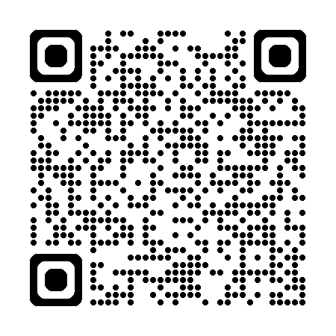
April-May New Org Bonus — one month left
Make it yours: Qualify for bonus credits and choose your Council year
Tracking available on Dashboard 2.0 > Recognition > Incentives
Pick your Council: Qualifiers for the 1,000 bonus Council Credits will have the opportunity to choose whether to apply them to Council year 2026 or 2027.
New Org agents have just 1 month left to qualify for a $300 bonus and 1,000 bonus Council Credits based on paid life cases in April and May.
Between April 1 – May 29, 2026:
Pay for 3 life cases (EWL 3:1; VUL excluded) to qualify for a $300 bonus
Pay for 1 additional life case for a total of 4 (EWL 3:1; VUL excluded) to also receive 1,000 bonus Council Credits
Scan the QR code for complete eligibility rules, payment details, and program terms on Info Central.
In some instances, cash bonuses may be withheld when an agent has reached the maximum legal allowance under the Conditional Check formula. For more information, see Life and Annuity Expense Allowance Plan on Info Central.
Notes:
April-May New Org bonus — 1 month left
Don’t miss this limited-time Bonus and Council Credits opportunity
The April-May New Org Bonus provides New Org agents with an opportunity to qualify for a $300 bonus and 1,000 bonus Council Credits based on paid life case activity between April 1 and May 29, 2026. Paying for 3 qualifying life cases earns the $300 bonus, and paying for 1 additional qualifying life case, for a total of 4, also earns 1,000 bonus Council Credits. EWL cases count on a 3:1 basis and VUL cases are excluded.
Newly announced, agents who qualify for the 1,000 bonus Council Credits will have the opportunity to choose whether those Credits are applied to Council year 2026 or 2027.
Complete program rules are available on Info Central, and the Life Sales Desk is available for support in reaching incentive and Council goals.
April-May New Org Bonus Info Central page: https://www.today.newyorklife.com/agencyportal/s/article/April-May-New-Org-Bonus
Contact: PLAN@newyorklife.com
¹ Cash bonuses are credited as part of the Life and Annuity Expense Allowance Plan (EAP) and subject to Conditional Check. New York State (NYS) Insurance Law regulates the amount of Expense Allowance that can be credited to an agent’s ledger. In some instances, cash bonuses may be withheld when an agent has reached the maximum legal allowance under the Conditional Check formula. For more information, see Life and Annuity Expense Allowance Plan on Info Central. Agents who are eligible to enroll in EAP must be enrolled by April 30, 2026, to receive a cash bonus. Agents not enrolled by April 30, 2026, will receive bonus Council Credits in lieu of a cash bonus. Agents on the Allowance Builder XP TAS Plan in General Offices located in Arizona, California, Illinois, Iowa, Montana, Nevada, New Hampshire, North Dakota, and South Dakota who are not eligible to enroll in EAP may be eligible for a cash bonus as a one-time payment through TAS, subject to TAS limits. Bonus credits through TAS may not exceed NYS legal limits for Training Allowance.
² Council Credits applied through this incentive do not count toward Cabinet qualification, or the 43,000 Council Credits required for Quality Council.

Slide 10

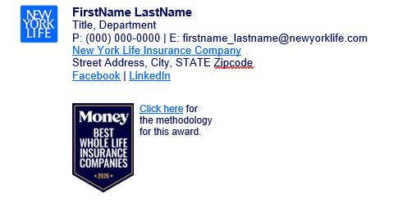
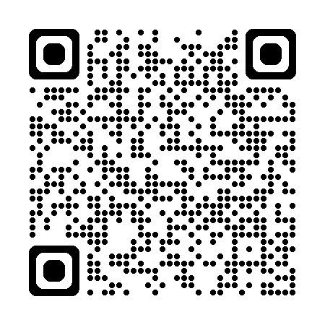
Money ranks New York Life Best in Whole Life for 2026
A trusted endorsement to boost client conversations and drive growth
Key highlights:
Recognized for multiple permanent life insurance options, a comprehensive selection of optional riders and a strong dividend history.
Celebrated for exceptional financial strength among the highest ratings awarded to US life insurers
Proudly continuing our legacy of annual dividend payments to participating policies since 1854 — with a record $2.78 billion declared for 2026.* * Dividends are not guaranteed.
2026 Money Badge Outlook email signature
Highlight New York Life’s top spot in Whole Life from Money magazine—add the new recognition to your email signature.
Scan the QR code to access the email signature, guidelines and other resources.
Money’s Best Life Insurance Companies list is based on a thorough evaluation of each provider’s ability to pay claims, product offerings, pricing, and financial strength. They also analyzed customer satisfaction, complaint data from the NAIC, and the ease of the underwriting process and gathered further insights from company interviews. Click here for more details on the methodology for this award.
Notes:
Money ranks New York Life Best in Whole Life for 2026
Money magazine ranked New York Life best in whole life insurance for 2026, giving agents and employees a strong third-party endorsement to reference in client conversations. The message reinforces New York Life’s broad permanent life product lineup, exceptional financial strength ratings, and long-standing dividend history, including the 2026 declared dividend. Agents can add the new Money badge to their email signature and use the QR code to access resources for sharing the recognition with clients.

Slide 11



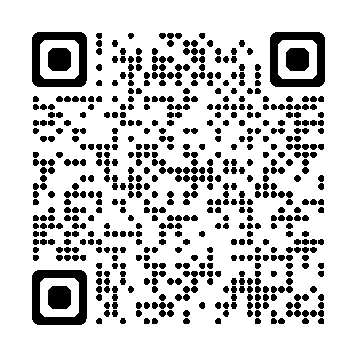
VUL Mastery webinar series - session 2
Keep the momentum going. Practical ideas for stronger VUL conversations.
Survivorship Variable Universal Life
Session 2
Monday, May 18, 2026 | 3 pm ET*
Focusing on SVUL Accumulator II (AD126), our new Survivorship Variable Universal Life (SVUL) solution, and how to position it with the right clients.
Key takeaways:
Why it matters now
Ideal client opportunities
Legacy planning ideas
Replay of May 6 PLAN webinar
Featured speaker:
Nicholas D. Hjorth CPA, CLTC
Chairman’s Cabinet
Anaheim Office
Catch up before Session 2. The May 6 PLAN webinar replay covers the new SVUL product and key strategies that tie directly into the VUL Mastery series.
Scan the QR code to register for session 2 of the VUL Mastery today.
*3:00 PM EST | 2:00 PM CST | 1:00 PM MST | 12:00 PM PST | 11:00 PM Alaska | 9:00 AM Hawaii
Notes:
VUL Mastery webinar series
Join us for VUL Mastery, a webinar designed to help you strengthen client conversations around variable universal life solutions.
Session 2 will focus on SVUL Accumulator II (AD126), our new Survivorship Variable Universal Life (SVUL) solution, and how to position it with the right clients.
To help you prepare, the May 6 PLAN webinar replay is now available. It introduces the new SVUL product and highlights key strategies and client opportunities that tie directly into this session—be sure to scan the QR code to watch the replay.
Contact: PLAN@newyorklife.com
Registration link: https://nylife.zoom.us/webinar/register/WN__dB8tQ_DSMeQ-Etwix2RMA#/registration
5/6 PLAN webinar replay: https://nylview.mediaspace.kaltura.com/media/Introducing%20SVUL%3A%20How%20to%20Position%20It%20and%20What%20to%20Do%20Next%20(5_6_26%20Replay)/1_s6g7qfn5/258903902

Slide 12

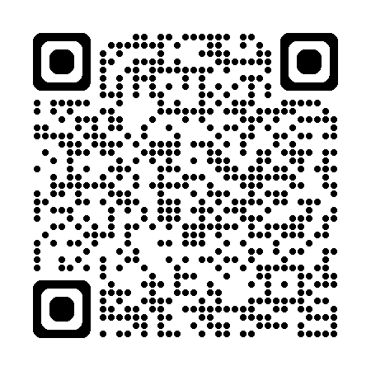
Disability Income Awareness Month (DIAM) training series
Practical strategies to grow your DI business
May 6
Unlocking Growth with Multi-Life IDI
Discover how Multi-Life can help you reach more clients and create new opportunities for individual DI conversations.
May 13
Beyond DIOP: Positioning the Right Coverage for Your Clients
Learn how to identify additional protection needs and guide clients toward more complete coverage solutions.
May 20
Closing Modified Offers: Turning UW Decisions into Placed Cases
Strengthen your ability to explain modified offers, overcome objections, and move more cases to placement.
May 27
Using Data & Tools to Find Better DI Opportunities
Use business-building tools and data insights to find qualified prospects and prioritize the right opportunities.
Live webinar series
Wednesdays in May | 4 pm ET*
Scan the QR code to sign up for the DIAM training series and save your spot for all four sessions.
*4:00 PM ET | 3:00 PM CT | 2:00 PM MT | 1:00 PM PT | 12:00 PM Alaska | 10:00 AM Hawaii
Notes:
Disability Income Awareness Month(DIAM) training series
Disability Insurance Awareness Month (DIAM) is the perfect opportunity to educate and engage your clients and prospects on the value of comprehensive income protection.
Join us for our DIAM webinar where our disability experts will share actionable strategies to position both individual and group disability with confidence!
Contact: PLAN@newyorklife.com
Registration link: https://nylife.zoom.us/webinar/register/WN_GfEarc3fRY6b6ND7j_D_3w#/registration

Slide 13

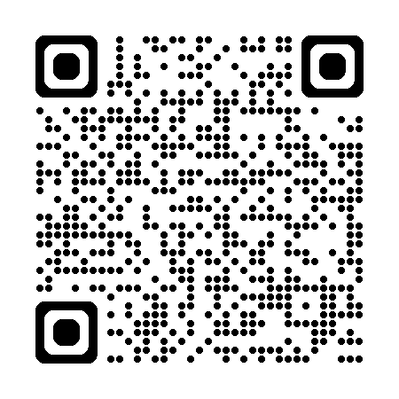
2Q 2026 Registered Rep MasterClass
Session 1 NYLIFE Securities and Mutual Funds: April 21, 2026, at 3:00 PM ET
Session 2 Variable Annuities, What You Need to Know April 28, 2026, at 3:00 PM ET
Session 3 Variable Annuity Riders IPR 5.0 and ADBR May 5, 2026, at 3:00 PM ET
Session 4 Positioning VUL and Market Wealth Plus May 12, 2026, at 3:00 PM ET
Session 5 Positioning IndexFlex May 19, 2026, at 3:00 PM ET
Session 6 Working in the Rollover Market May 26, 2026, at 3:00 PM ET
Session 7 Understanding IRA Opportunities June 2, 2026, at 3:00 PM ET
Session 8 Annuity New Business and Suitability June 9, 2026, at 3:00 PM ET
Session 9 Small Business Solutions June 16, 2026, at 3:00 PM ET
Session 10 Benefits of College 529’s June 23, 2026, at 3:00 PM ET
Session 11 Morningstar: Researching Funds June 30, 2026, at 3:00 PM ET
Strengthening the foundation
11-part quarterly series - Tuesdays at 3pm ET
Educates on NYL products
Interactive sessions with product experts
Provides ongoing education
Register today to ensure prompt access to these highly anticipated events.
Events start at 3 pm ET* and run 60 minutes.
*3:00 PM ET | 2:00 PM CT | 1:00 PM MT | 12:00 PM PT | 11:00 PM Alaska | 9:00 AM Hawaii
Notes:
2Q 2026 Registered Rep MasterClass
Starting Tuesday April 21st at 3pm EST running for 11 weeks
Contact: PLAN@newyorklife.com
Registration link: https://nylife.zoom.us/webinar/register/WN_blUdrLegQluNnil5eJb-Gg

Slide 14




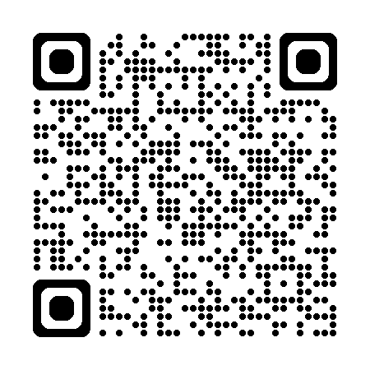
Register for the Mutual Income webinar
Council Close: Drive Protection and Better Retirement Outcomes with Mutual Income
Date: Wednesday, May 20, 2026 Time: 3 pm ET
Featured speakers
Moderator
2:00 pm CT | 1:00 pm MT | 12:00 pm PT | 11:00 am AKT | 9:00 am HT
Join field and home office leaders for practical ideas on positioning Mutual Income in client conversations.
Explore why Mutual Income can be a powerful advantage in income planning conversations
Hear how Mark Derby has successfully integrated Mutual Income into his practice
Learn positioning ideas that can help enhance client protection and support stronger retirement outcomes
Mark Derby
President’s Council
and Diamond Annuity
Elite Member
Justin Bateman
CVP
Advanced Income Solutions
Josh Bauer
Investment Product Consultant
Pacific Zone
Scan the QR code and register for the Mutual Income webinar today.
Notes:
Register for the Mutual Income webinar
The upcoming Mutual Income webinar will take place on Wednesday, May 20 at 3:00 p.m. ET. Council Close: Drive Protection and Better Retirement Outcomes with Mutual Income, this session will share practical ideas for positioning Mutual Income in client conversations.
Featured speakers Mark Derby and Justin Bateman, with Josh Bauer as moderator, will discuss how Mutual Income can serve as a competitive advantage in income planning, how it has been successfully incorporated into practice, and how it can help support stronger client protection and better retirement outcomes.
Registration link: https://nylife.zoom.us/webinar/register/WN_SdYfBtMQSNWR4RmyWKy3jQ

Slide 15
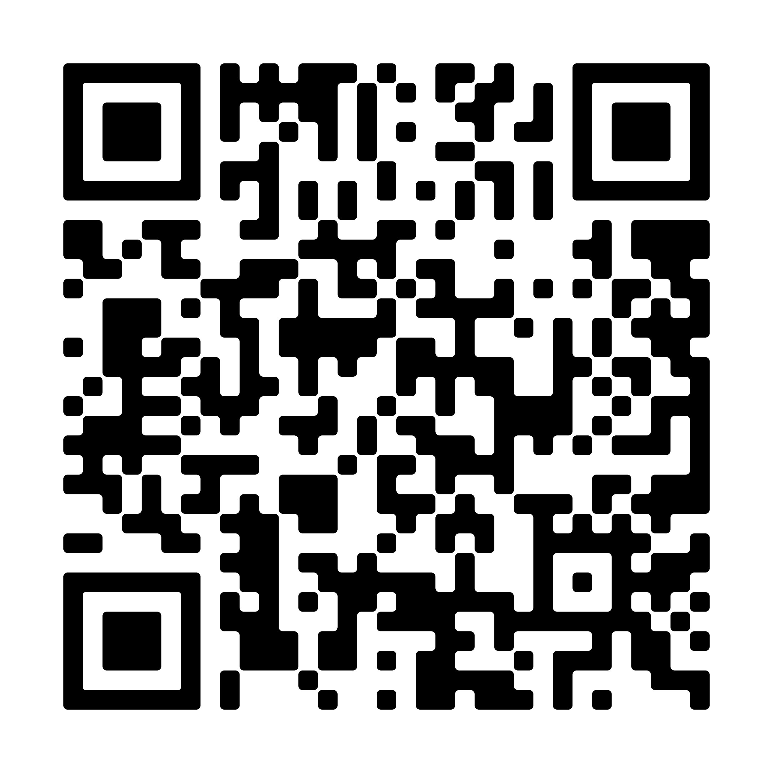
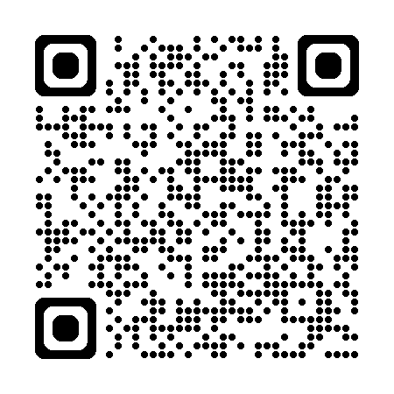
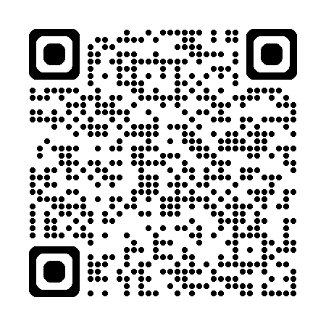
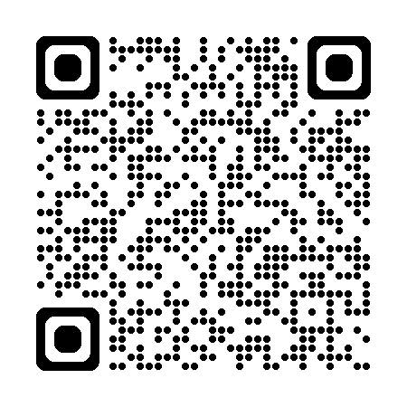
Target Markets upcoming webinars
AAMU Strong: Council Close
Monday, May 18, 4 pm ET
Korean Market Agents Resource Lab
Monday, May 18, 6 pm ET
Scan the QR code to register today!
Scan the QR code to register today!
As you close out towards Council, come hear some great ideas to help you get to the finish line or RISE to the next level!
Monthly in-language training and development hour on tools and resources followed by Q&A
South Asian Market Key to Success
Monday, May 18, 4 pm ET
Vietnamese Market Business Development
Monday, May 18, 4 pm ET
Scan the QR code to register today!
Scan the QR code to register today!
Webinar designed to empower agents with actionable strategies, industry insights and opportunities to elevate their business.
ClientMine: Identify the planning gaps
Notes:
AAMU Strong: Council Close
(for New Org, Estab and Second Line Managers)
As you close out towards Council, come hear some great ideas to help you get to the finish line or RISE to the next level!
Guest speakers:
Joe Baumgartner, CFA, Senior Investment Solutions Consultant SC Zone
Jackie Caldwell, CLU, RICP Life Solutions Consultant SC Zone
Contact: africanamericanmarket@newyorklife.com Registration: https://nylife.zoom.us/meeting/register/XQiOaW_ESyiCmTwOsLKtVw
Submitted by: John Macchia
-- -- --
Korean Market Agents Resource Lab
(for New Org, Estab and Second Line Managers)
Monthly in-language training and development hour on tools and resources followed by Q&A
Contact: targetmarkets@newyorklife.com
Registration: https://nylife.zoom.us/meeting/register/Xo5x6s4hShq4FiHBPSzXpw
Submitted by: John Macchia
-- -- --
South Asian Market Key to Success
(for New Org, Estab and Second Line Managers)
Webinar designed to empower agents with actionable strategies, industry insights and opportunities to elevate their business.
Contact: targetmarkets@newyorklife.com
Registration: https://nylife.zoom.us/webinar/register/WN_f3aeTgdpSBuor2kFCC1CoA
Submitted by: John Macchia
-- -- --
Vietnamese Market Business Development
(for New Org, Estab and Second Line Managers)
ClientMine: Identify the planning gaps
Contact: targetmarkets@newyorklife.com
Registration: https://nylife.zoom.us/meeting/register/_Ee-io1vT5a73WQ6I6uamg
Submitted by: John Macchia

Slide 16
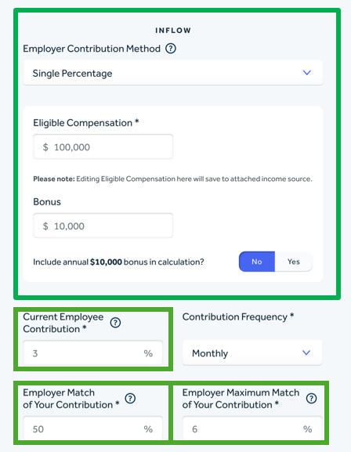
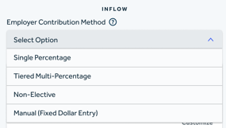
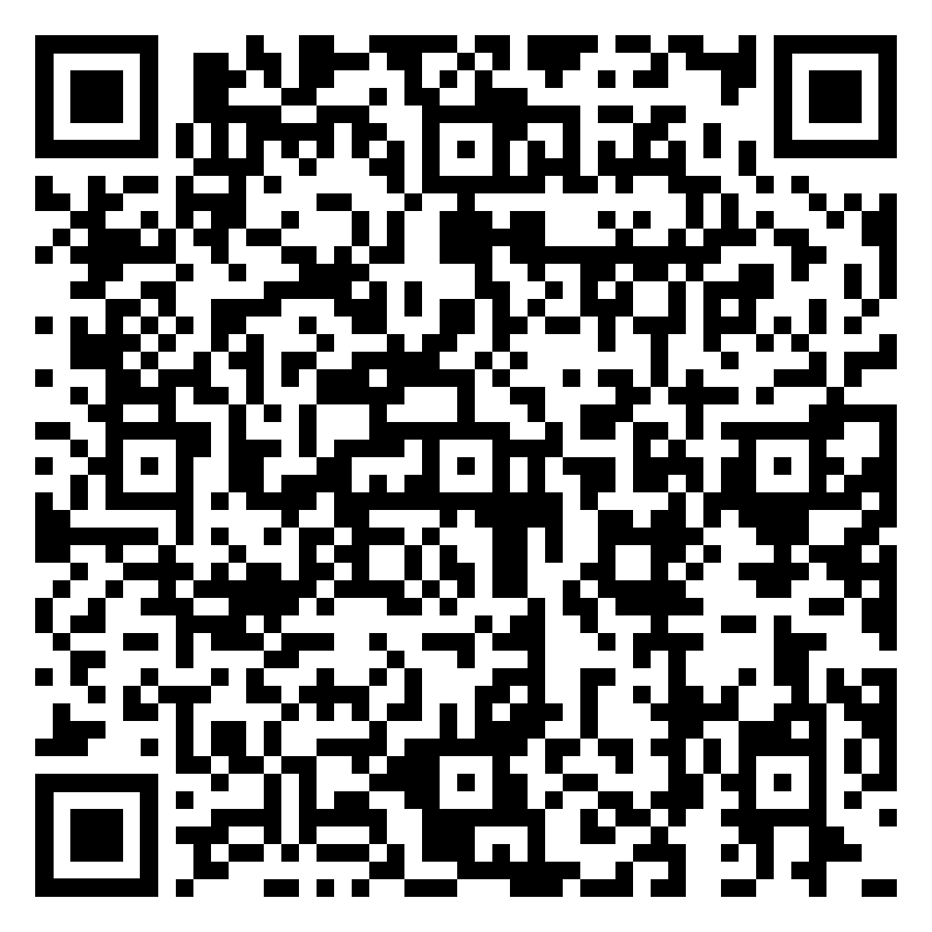
Capture benefits faster with Discovery simplified
Employer contributions and 401(k) match rules now auto-calculate
NEW - Discovery Simplified Features Enabled
What’s new
Enter employer benefits directly within occupation details
Define 401(k) match rules — automatic calculation, no manual work
Income screen data auto-populates the Financial Snapshot
Why it matters
Improves accuracy for Retirement Assessment and MBS
Ties employer benefits directly to income for a complete picture
No need to manually calculate an employer's match. The tool calculates based off income and method. Also helps tie benefits to income
.
Learn more about the latest GuideMe enhancements
For internal use only. Not for use with the public.
SMRU 8837959 New York Life Insurance Company(NY,NY)
Notes:
Donna Weiser
drweiser@newyorklife.com
Released Retirement Account Employer Contributions Calculated – Income benefits tied to income model including 401K calculations, employer DI and employer life

Slide 17
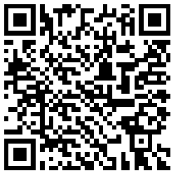
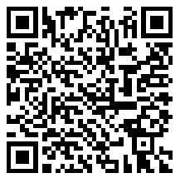
Earn Your FSCP® or RICP® designation in 2026
Study cohorts starting in July - Register by June 10 to reserve your spot
Why join a cohort?
Whether you’re planning to start or finish your designation this year, a cohort is the most effective way to stay on track and complete it.
Stay accountable, prepare with support, and build momentum toward your FSCP® or RICP® designation.
FSCP® & RICP ® Cohorts — scan to register
Select the survey that matches your role and course
PMF-enrolled Agents^
Agents + Managers
Key dates
June 10
Deadline for cohort enrollment.
Cohort kick-off session.
If you’re unable to attend the kick-off due to focus on Council close, no worries – you can still join the cohort sessions in July.
June 23
Week of July 6
Weekly study sessions begin.
Scan QR code to complete the cohort interest survey.
FSCP® cohort
FSCP® & RICP® cohorts
1
2
Enroll in your applicable American College course; course enrollment is required to participate*. Enroll for July 1 course start.
^ If you are currently enrolled in the Practice Model Foundations (PFM) learning plan in NYLIC U, choose the survey on the left.
3
Watch for cohort kick-off details after you opt in.
* For questions or assistance with course enrollment, connect with your Development Manager or send an email to PracticeModels_Support@newyorklife.com.
Notes:
Questions contact
PracticeModels_Support@newyorklife.com
sean_gilrein@newyorklife.com
PMF-enrolled agents QR Code:
https://research.newyorklife.com/jfe/form/SV_8HpelTDQXec76wS
Agents + Managers FSCP/RICP QR Code:
https://research.newyorklife.com/jfe/form/SV_8jpfcXNLuCa7t1Y

Slide 18
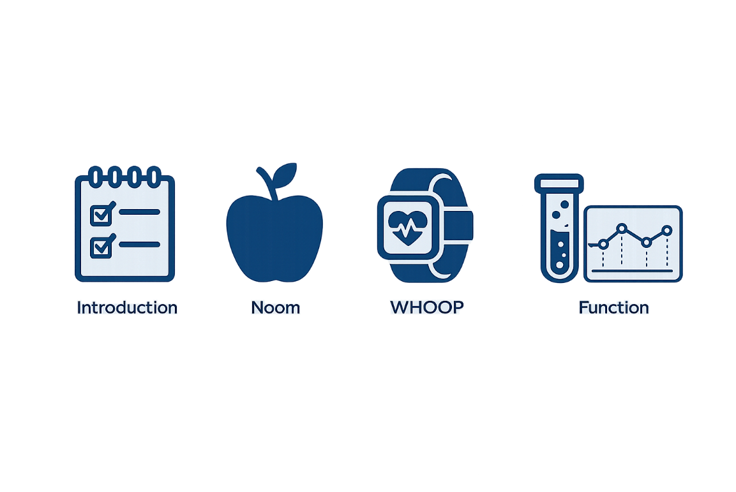
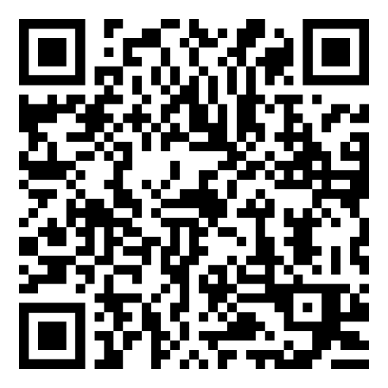
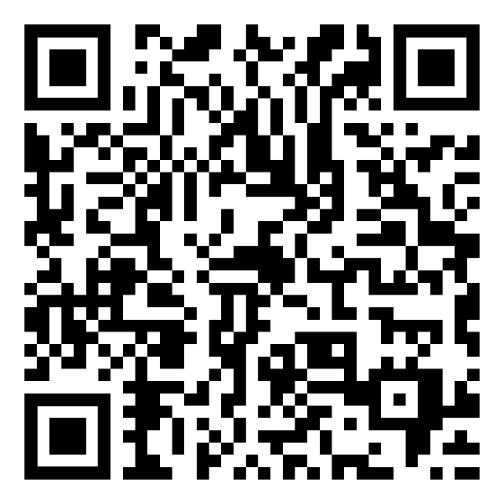
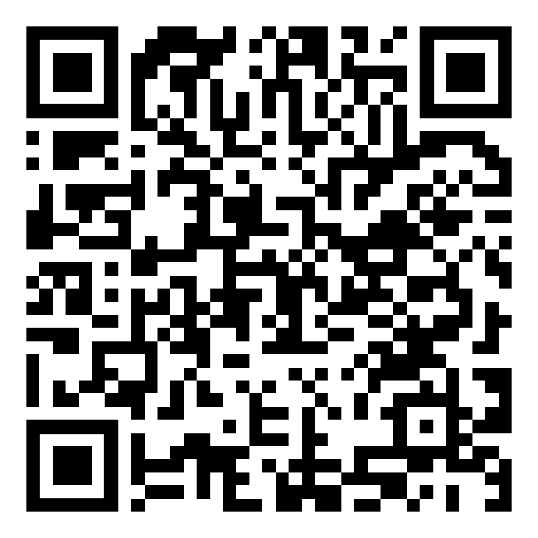
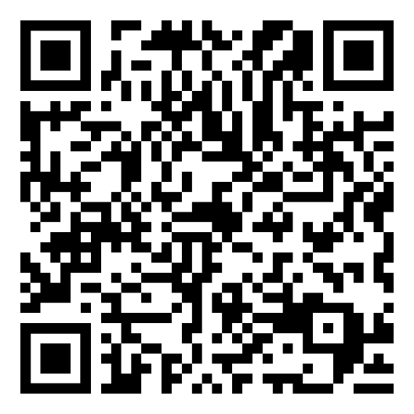
Attend the NYL Healthy Living series and learn about the new program for policyholders Available to call clients with policies from Arkansas, Colorado, Connecticut, Georgia, Minnesota, Pennsylvania
Recordings will be available | Questions? Contact nylhealthyliving@newyorklife.com
Introduction
Spotlight: Noom
Spotlight: Function
Spotlight: WHOOP
Overview of NYL Healthy Living
Talking Points w/ clients
Resources to get started
Guest speakers
Learn about Noom’s weight management tools
Noom helps you make behavioral changes to live longer with access to apps and medication
Learn about Function’s biomarker tracking
Function’s mission is to help you live 100 healthy years by helping you track patterns through lab tests
Learn about WHOOP’s 24/7 wearable health tracker
WHOOP tracks your sleep, strain, and stress to coach you in improving your healthspan
Mon. May 18: 2 – 2:45 pm ET
Mon. May 18: 4 – 4:45 pm ET
Thurs. May 21: 1 – 1:45 pm ET
Tues. May 27: 3 – 3:45 pm ET
Registration Link
Registration Link
Registration Link
Registration Link
These optional services from third party service providers are accessible through a partnership with New York Life Insurance Company (“New York Life”). The third-party service providers/companies represented are not affiliated with New York Life Insurance Company or any of its affiliates. The logos and other identifying marks attached are trademarks of and owned by each represented company and/or its affiliates. The service providers are solely responsible for the services and any discounts they provide. You have a choice to engage with the providers for their services. If you choose to do so, those engagements will be governed by the particular applicable terms and conditions of the respective provider. The service providers are solely responsible for the services they provide. You will be responsible to pay any fees or cost associated with the selected service directly to the service provider. New York Life is not responsible for the cost of these services or the relationship with these service providers. Offer not available in all states and limited to designated products. Participation in any Health and Wellness service is intended solely for the individual recipient of this communication and may not be transferred, shared, or used by others and is limited to designated products. Participation in any Health and Wellness service is intended solely for the individual recipient of this communication and may not be transferred, shared, or used by others. The access to these services may be discontinued at any time. Following New York Life Insurance Company’s discontinuance of the program, you can continue the services directly through the service providers or obtain new services at the fees, if any, set by the service providers.
SMRU# 8921478 Exp. 5/11/2029
Notes:
stephanie_liftman@newyorklife.com
Join next week’s New York Life Healthy Living webinar series to learn how eligible policyowners can access exclusive discounts on vetted longevity-related brands including WHOOP, Function, and Noom. These tools are designed to help clients live longer, healthier lives.
The program is currently available to clients with Life, IDI, LTC, or Income Annuity policies issued in six states : Arkansas, Connecticut, Colorado, Georgia, Minnesota, and Pennsylvania.

Slide 19

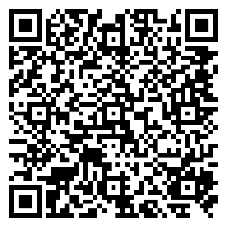
Tune in quarterly: The Elevate Podcast
Listen now: Episode 1: Removing friction from new business and underwriting
New quarterly podcast series hosted by Aaron Ball, EVP and Head of the Foundational Business, and Sonali Virendra, SVP and Head of Agency:
Episode 1: Removing friction from new business and underwriting feat. Steve Abramo, SVP, Purchase Experience Value Stream
Watch or listen on NYL View
Notes:
Chris Falvo: christopher_falvo@nyl.com
The Elevate Podcast is a new quarterly podcast series hosted by Aaron Ball, EVP and Head of the Foundational Business, and Sonali Virendra, SVP and Head of Agency, and connects New York Life’s Foundational Business strategy and progress to what it means for agents and advisors. Learn how the company is bringing our Protection-Powered GrowthTM strategy to life in the field with improvements that reduce friction and boosts productivity.
In the first episode, Aaron and Sonali are joined by Steve Abramo, Senior Vice President, Purchase Experience Value Stream, to discuss work underway to make the new business and underwriting experience smoother and easier to navigate. The conversation focuses on reducing friction in the purchase experience so agents can spend less time managing process pain points and more time serving clients.
You can watch the video or listen while on the go on NYL View.

